Slide 1



Progress on MISRA C++
DARP workshop, York, 18th April 2007
Chris Tapp Keylevel Consultants Ltd.
Dr C H Pygott QinetiQ

Slide 2
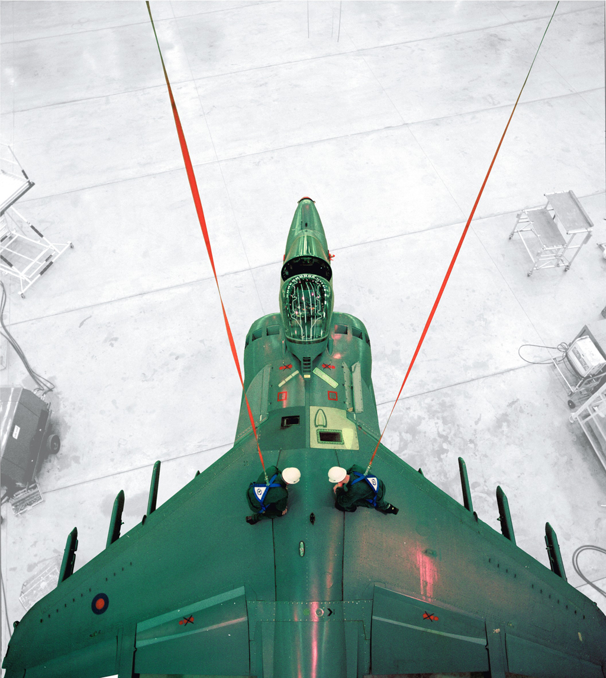
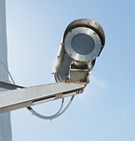
MoD and MISRA C++
These opinions are the presenters and not necessarily MISRA’s

Slide 3
MoD Computing Policy - History
In the 1980’s, MoD had a prescriptive requirement for software in Ada
This led to investment in Ada-based tools and techniques particularly SPARK Ada for safety related and safety critical applications
In the late 80’s early 90’s, the policy became to be ‘as commercial as possible’ with no recommended language
Commercial developments have been dominated by C, C++ and lately Java

Slide 4
Why sub-set for Safety Related/
Critical use?
The prime requirement for safety critical use is predictability
All software languages have features that are unpredictable
The aim of a coding standard is to eliminate or mitigate such unpredictability
Unpredictability may be:
unspecified behaviour – it is simply not known what the program will do
implementation dependant – different behaviour on different platforms
unknown execution time
unknown resource requirements

Slide 5
Effect of MoD Computing Policy moving away from Ada
SPARK Ada is still technically an acceptable solution for safety related systems and many MoD systems are still developed in it
The initial thrust for Ada support, came from DoD who commissioned the definition of the language
This was damaged, when DoD also stopped mandating Ada
Ada is (apparently) a less feature-rich language, than say C++
Compiler and support tool suppliers concentrated on C and C++
As did university computer science courses leading to a shortage of Ada programmers
Which encourages developers to move away from Ada further depressing the demand for Ada and leading to a vicious circle

Slide 6
Use of C in MoD Safety Related/Critical Systems
There are many MoD projects using C for safety related (SIL1 and SIL2) applications
usually, these are based on using MISRA C
possibly with project specific enhancements
The level of evidence required for safety critical (SIL3 and SIL4) is higher
it not only requires control of unpredictability
it also requires the ability to (mathematically) prove a program correct
Under CRP and RAO Output 3 funding, a further constrained subset of MISRA C has been developed, C♭
this has tool support for formal verification
has been used to develop and certify a SIL4 avionics application

Slide 7
Use of C++ in MoD Safety Related/Critical Systems
C++ has been used on ground-based safety related applications with very little control of the language subset used
these had no real-time or continuous control requirements
‘blue screen of death’ was not an issue
main hazard was ‘plausible but wrong’ output
acceptance based on rigorous testing and limitation on use of output
Some 4 or 5 years ago, Lockheed Martin announced that they would be using C++ for some of the safety related avionics software on JSF
this is considerably beyond MoD’s previous experience with S/R C++
it was also beyond what was being done with C++ in other industries

Slide 8
Conclusions from the work on C++ for JSF
Lockheed Martin generated a C++ coding standard
known as JSF++ and based on MISRA C
reviewed (under contract) by US and UK academia
including Bjarne Stroustrup - the inventor of the language
available at: http://www.jsf.mil/downloads/down_documentation.htm
It has been concluded that JSF++ is appropriate for JSF
but it is not ideal as a general solution:
    its not in the public domain (the published version is missing one security related section)
    it has not been subjected to public peer review

Slide 9
Developing a Rational Basis for a C++ Coding Standard
One issue that hampers the review of JSF++ was a lack of agreement as to what aspects of the language needed to be controlled
As a partial solution, QinetiQ generated a ‘vulnerabilities report’
This lists all the issues described in the C++ language standard as ‘implementation defined’, unspecified’ etc.
To summarise:
Category | Issues | Safety?
Unspecified behaviour | 31 | Yes
Undefined behaviour | 81 | Yes
Implementation behaviour | 62 | No?
Indeterminate behaviour | 5 | Yes
Behaviour that requires no diagnostic | 19 | No

Slide 10
MISRA C++ and the ASSC
At a DARP workshop (April 2005) it was asked ‘what is needed to make C++ acceptable for future safety related avionic applications?’
It was decided that what was required was “MISRA C++”, that is:
    a coding standard in the style of MISRA C
    a particular strength of MISRA C being seen as its wide cross industry acceptance as best practice
At that time MISRA were expressing disinterest in C++
so ASSC was approached to provide the focus for an avionics industry led standard
A subsequent automotive requirement meant MISRA became interested
In order to avoid competing standards, the fledgling ASSC led team was absorbed into a MISRA C++ working group
Hence “MISRA C++” became MISRA C++
    i.e. from a standard for C++ in the style of MISRA C, to one from the same organisation as MISRA C, produced in the same way
Notes:
The quotes are significant!

Slide 11
Relationship between C, C++, MISRA C/C++, JSF++ and C♭
JSF++
C♭♭ ?
C♭
MISRA C
MISRA C++
C++
C
Thanks to Paul Caseley

Slide 12

MISRA C++
and
MoD Software
Safety Requirements
These opinions are the presenters and not necessarily MISRA’s

Slide 13
MoD Software Safety Requirements
Many current projects contracted to Def Stan 00-56 issue 2 (1996)
    General Safety Management
    Calls up Def Stan 00-55 issue 2 (1997) for software specific aspects
Def Stan 00-56 updated to issue 3 in 2004
    Less prescription the issue 2
      ‘these are the issues that must be addressed’
      ‘tell us how you are going to address them, and why that should be acceptable’
    No specific software requirements
      but still refers to Def Stan 00-55 issue 2 as acceptable guidance

Slide 14
Reminder
  Hazards ranking:
    SIL4 -- safety critical to
    SIL1 -- slightly safety related
  Def Stan tailoring:
    M – mandatory
    J1 – needs strong justification to omit
    J2 -- needs justification to omit

Slide 15
DS 00-55 Requirements for Programming Languages
Paragraph | Requirement | S4 | S3 | S2 | S1
28 | Selection of Language
28.1 | High-level language requirements. The SRS shall, except where permitted in ref28.5, be programmed in an implementation language which is a high-level language, or pre-defined subset of a high-level language. This implementation language shall have the following characteristics:
28.1a | strongly typed; | M | M | J1 | J2
28.1b | block structured; | M | M | J1 | J2
28.1c | formally-defined syntax; | M | J1 | J1 | J2
28.1d | predictable program execution. | M | J1 | J1 | J2

Slide 16
DS 00-55 Requirements for Coding Standards
Paragraph | Requirement | S4 | S3 | S2 | S1
36 | Coding Process
36.1 | Coding standards
36.1.1 | The code shall be written in accordance with coding standards | M | M | J1 | J1
36.1.2 | The coding standards shall define rules that lead to clear source code that is analysable by formal arguments and static analysis. | M | M | J1 | J1
36.2 | The implementation language and coding standards used shall conform to the Code of Design Practice. | M | M | M | M
36.3 | Justification shall be provided to show that the code is not affected by any known errors in the compilation system or target hardware. | M | M | J1 | J2
36.4 | If the run-time system or operating system upon which the SRS is based is not written especially for SRS, it shall conform to the requirements of clause 30. | M | M | J1 | J2
36.5 | Static analysis and formal verification
36.5.1 | Static analysis in accordance with ref 26.2 shall be performed on the whole of the source code to verify that the source code is well formed and free of anomalies that would affect the safety of the system. | M | M | J1 | J1
36.5.2 | Proof obligations shall be: | M
36.5.2a | constructed to verify that the code is a correct refinement of the Software Design and does nothing that is not specified; | M | M | J1 | J2
36.5.2b | discharged by means of formal argument. | M | M | J1 | J2
36.5.3 | The requirements of this Standard for static analysis and formal verification shall include any run-time system software, unless this is covered under refclause 30. | M | M | J1 | J2

Slide 17
Why have Subsets?
To avoid undefined behaviour
  e.g. for C and C++, dividing by zero or dereferencing a NULL pointer
  the language reference provides no definition of what behaviour to expect
To avoid implementation defined behaviour
  e.g. the size of an integer
  The compiler developer must document the decision taken
  Leads to un-portable code
  May mislead a programmer moving to a different programming environment
To improve clarity for review and maintenance.
  e.g not allowing 'count1' and 'countl' as variable names in the same program
  objective issue and solution
To provide a consistent style across a program or set of programs
  e.g. name format (Hungarian notation etc) or code layout
  similar to improving clarity - but subjective

Slide 18
Why have Subsets? continued
To avoid common programmer errors
  e.g not confusing if (x = y)... and if (x == y) ...
  no exhaustive list of errors to be address
  extract from programming guides like
    Dewhurst ‘C++ Gotchas’
    Meyers ‘Effective C++’
To incorporate good practice, particularly with regard to ‘future proofing’.
  e.g. ‘only throw objects of class type’ (PRQA 9.2)
  Doesn’t protect against any particular problems or assist clarity,
  but does allow code to be re-used with less likelihood of requiring a major rewrite.

Slide 19
Topics addressed by MISRA C++
  ✓
  To avoid undefined behaviour
  To avoid implementation defined behaviour
  To improve clarity for review and maintenance.
  To provide a consistent style across a program or set of programs
  To avoid common programmer errors
  To incorporate good practice, particularly with regard to
  ‘future proofing’.
  ✓
  ✓
  ✗
  ✓
  ✗

Slide 20
Conclusions
MISRA C++ will (should!) satisfy the safety requirements of Defence
Standard 00-55
MISRA C++ will not of itself provide:
a ‘style’ guide for naming and layout
a ‘good practice’ guide for future proofing
Projects may need to create or adopt additional guidance in these areas
MISRA C++ is an acceptable basis for SIL1 and SIL2 applications
MISRA C++ does address predictability
this may provide the foundation for future formal verification tools
currently, no such tools are known
so C++ cannot be recommended for SIL3 or SIL4 applications

Slide 21
MISRA C++ Development Process
Chris Tapp

Slide 22
Team Members
All members of the MISRA-C++ Working Group are unpaid volunteers.
Core technical members:
  Richard Corden, Programming Research
  Mike Hennell, LDRA
  Derek Jones, Knowledge Software
  Clive Pygott, QinetiQ
  Chris Tapp, Keylevel Consultants (Chairman)
MIRA provide admin and IT services for MISRA.
  David Ward provides significant organisational assistance.

Slide 23
MISRA C++ Process
Identification of Issues
  QinetiQ Vulnerabilities Report
Evaluation of Existing Material
  Other Coding Standards
    MISRA-C
    JSF++
    Medical Systems
    Transportation
    Tool Vendors (‘real world’ experience).
  Other Publications
    Scott Meyers
    Stephen Dewhurst
    Etc.

Slide 24
MISRA C++ Process
New Rule Formulation
  Needed where existing material fails to cover identified issues or where better enforcement is required.
  Broken into ‘features’ that are championed by a sponsor (e.g. Clive / Exceptions).
  Can be difficult to decide where to add the rules if the issue is common to more than one section.

Slide 25
MISRA C++ Process
Peer Review
  Rules are reviewed by the organisations involved in the development process as soon as they become reasonably stable.
  A Draft Document will be put out for review to a wider set of reviewers.
  Please feel free to take part!
  Contact Chris Tapp (or via CHP)
  All feedback will be analysed and any major changes put out for further review.

Slide 26
MISRA C++ Process
The final document will be released when:
  Peer review is complete.
  The Working Group are satisfied with the quality of the document content.
  The MISRA Steering Group give approval for release.

Slide 27
MISRA C Rules
Many of the issues with C++ are shared with C, so MISRA-C has also been used as a source of rules.
  Some MISRA-C rules can be used ‘as is’.
  Some MISRA-C rules require minor changes.
  Some MISRA-C rules require significant re-work but are still useful.
  Some MISRA-C rules are not applicable to C++.

Slide 28
MISRA C++ Document
Subset will target ISO/IEC 14882:2003 C++.
Layout will be similar to MISRA-C and will be targeted at programmers.
Rules will be grouped so as to follow ISO/IEC 14882 section numbers.
Cross Reference tables will be provided, allowing tracing to/from the QinetiQ Vulnerabilities Report.
Document planned to be released as
  Paper Copy
  Corporate Licence / pdf
  Personal pdf

Slide 29
Rule set features
Floating point and fixed point arithmetic banned
  With the expectation that these rules will be deviated – but the project will have to show they know how to address the concerns raised
No language construct entirely banned, including:
  goto
  templates
  exceptions
  multiple inheritance
I have the draft rule set here if anyone wants to investigate a particular feature

Slide 30
Timescales
Chris Tapp

Slide 31
Outstanding Work
Item | Due Date (CHP’s guesses)
Production of Internal Review Draft | Ongoing
Internal Review | Ongoing
Analyse internal feedback and produce External Review Draft | End April
External Review | Mid May
Analyse external feedback and produce Final Draft | September
Release | Year end?

Slide 32
Long-term Quality Assurance
Request for Assistance
At the 2006 work shop, the need for ‘user feedback’ to improve and validate the rules was identified
  Do some rules give too many false positives?
  Are some rule frequently deviated – if so, why?
Still an un resolved issue – as MISRA is not involved contracting for or certifying products that use the standard
Suggestions welcome

Slide 33
Open Session
Questions Please!

